Slide 1
Print the Simple Hello Message in PHP

Slide 2
Perform String Operation Using PHP
String Length
Concatenation Operator
strpos() function

Slide 3
Print the 1 to 10 number using do while loop
$i=0;
do
{
$i++;
echo "The number is " . $i . "<br />";
}
while ($i<5);

Slide 4
Perform Arithmetic operation using function
<?php
function add($x,$y)
{
$total = $x + $y;
return $total;
}
echo "1 + 16 = " . add(1,16);
?>

Slide 5
Create a PHP program to Print Fibonacci Series.

Slide 6
<input text='text' name='r' value='<?php $r=$_POST['r'];echo $r;?>'>
echo "$i,$j,";
for($k=1;$k<=$r-1;$k++)
{
$f=$i+$j;
$i=$j;
$j=$f;
echo "$f,";
}

Slide 7
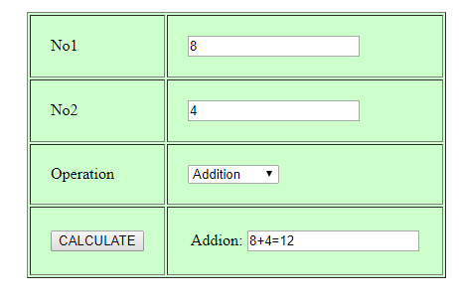
Create Calculator in PHP

Slide 8
<input type="text" name="no1" value="<?php $no1=$_POST['no1']; echo $no1;?>">
<?php
echo '<select name="operation">';
if(!empty($_POST['operation']))
{
switch($_POST['operation'])
{
case 'Add':
{
echo '<option>Menu</option>';
echo '<option value="Add" selected>Addition</option>';
echo '<option value="Sub">Subtraction</option>';
break;
}
}
}
Else{}
echo '</select>';
?>

Slide 9
<input type="submit" name="calc" value="CALCULATE">
if($_POST['calc']=='CALCULATE')
{
if($_POST['operation']=='Add')
{
$no3 = $no1 + $no2;
echo "<table><tr><td>Addion:</td>
<td><input type='text' name='ans' value='$no1+$no2=$no3'></td>";
}

Slide 10
Write following program in PHP: i. Change background color based on hour of a day.
date_default_timezone_set("Asia/Calcutta");
$hrs=date("h");
echo "<centet>Hours:$hrs</center>";
if($hrs>=0 and $hrs<=1)
{
$bgcolor='blue';
}
else if($hrs>=2 and $hrs<=3)
{
$bgcolor="orange";
}
echo"<body bgcolor=".$bgcolor.">\n";

Slide 11
Display the your name, roll no, department using form handling

